Slide 1


AMSTERDAM CITY PROJECT

Slide 2
10Bln
2050
7Bln
2020
Notes:
(This problem will only increase) as the world population grows from 7 (CLICK)
to 10 billion in the next 30 year.
(To effectively “feed the planet”…)

Slide 3
DEFORESTATION
20 soccer fields of forest/minute
Notes:
(We are creating new agricultural land) by Deforestation.
We have already halved the worlds forests in the last 100 years.
Right now, we are loosing 20 soccer fields of forest every minute...
And Agriculture is the #1 driver.
(Over fertilization results in…)

Slide 4
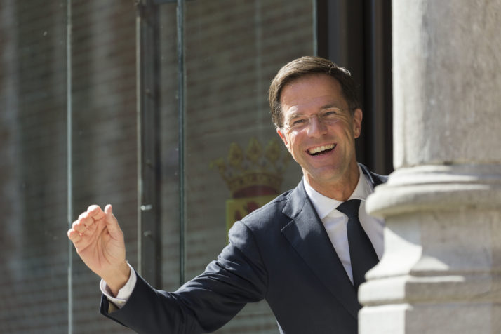
‘The greatest threat to our planet is the belief that someone else will save it.’
“We’re all in this together.” – Mark Rutte at P4G Copenhagen Summit 2018
Notes:
And how can we do it you say. Just an example

Slide 5
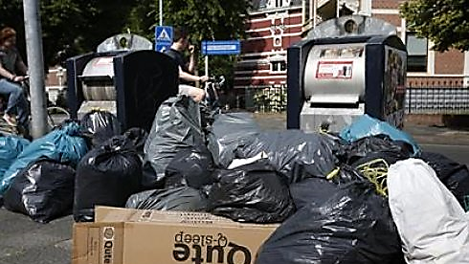
60%
Items you throw could actually be recycled

Slide 6

6-10%
World energy Consumption
Notes:
By using the Internet less can which cut down on greenhouse gas emissions, as it makes up 6-10% of the world’s energy consumption. And Netherlands has taken already few steps.
Source:https://www.greenjournal.co.uk/2020/01/what-would-2020-look-like-if-everyone-kept-their-new-years-sustainability-resolutions/

Slide 7
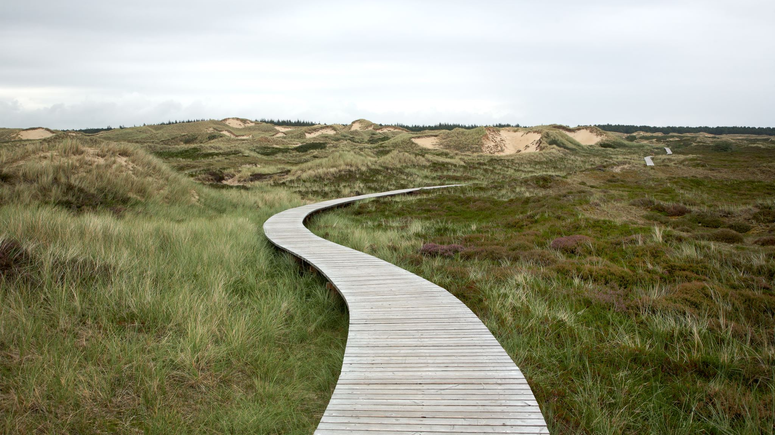
80 %
waste recycled
1.3
bikes
per inhabitant.
853
megawatts
of solar power
100%
wind energy
Use in Schiphol airport
Notes:
First steps have been already taken to work together for a sustainable and a greener planet. Of all generated waste, nearly 82 percent is recycled, putting the Netherlands in third place within the EU. Travelling by bike, which leads to an average of 1.3 bikes per inhabitant. Netherlands installed 853 megawatts of solar in 2017, which was an increase of 60% in one year. Schiphol airport, for example, has partnered with energy company Eneco to convert the airport to 100% wind energy by the end of this year . And how does Amsterdam fare as the capital of the Netherlands
Source:https://www.cbs.nl/en-gb/news/2018/10/netherlands-closer-to-achieving-sustainability-goals

Slide 8
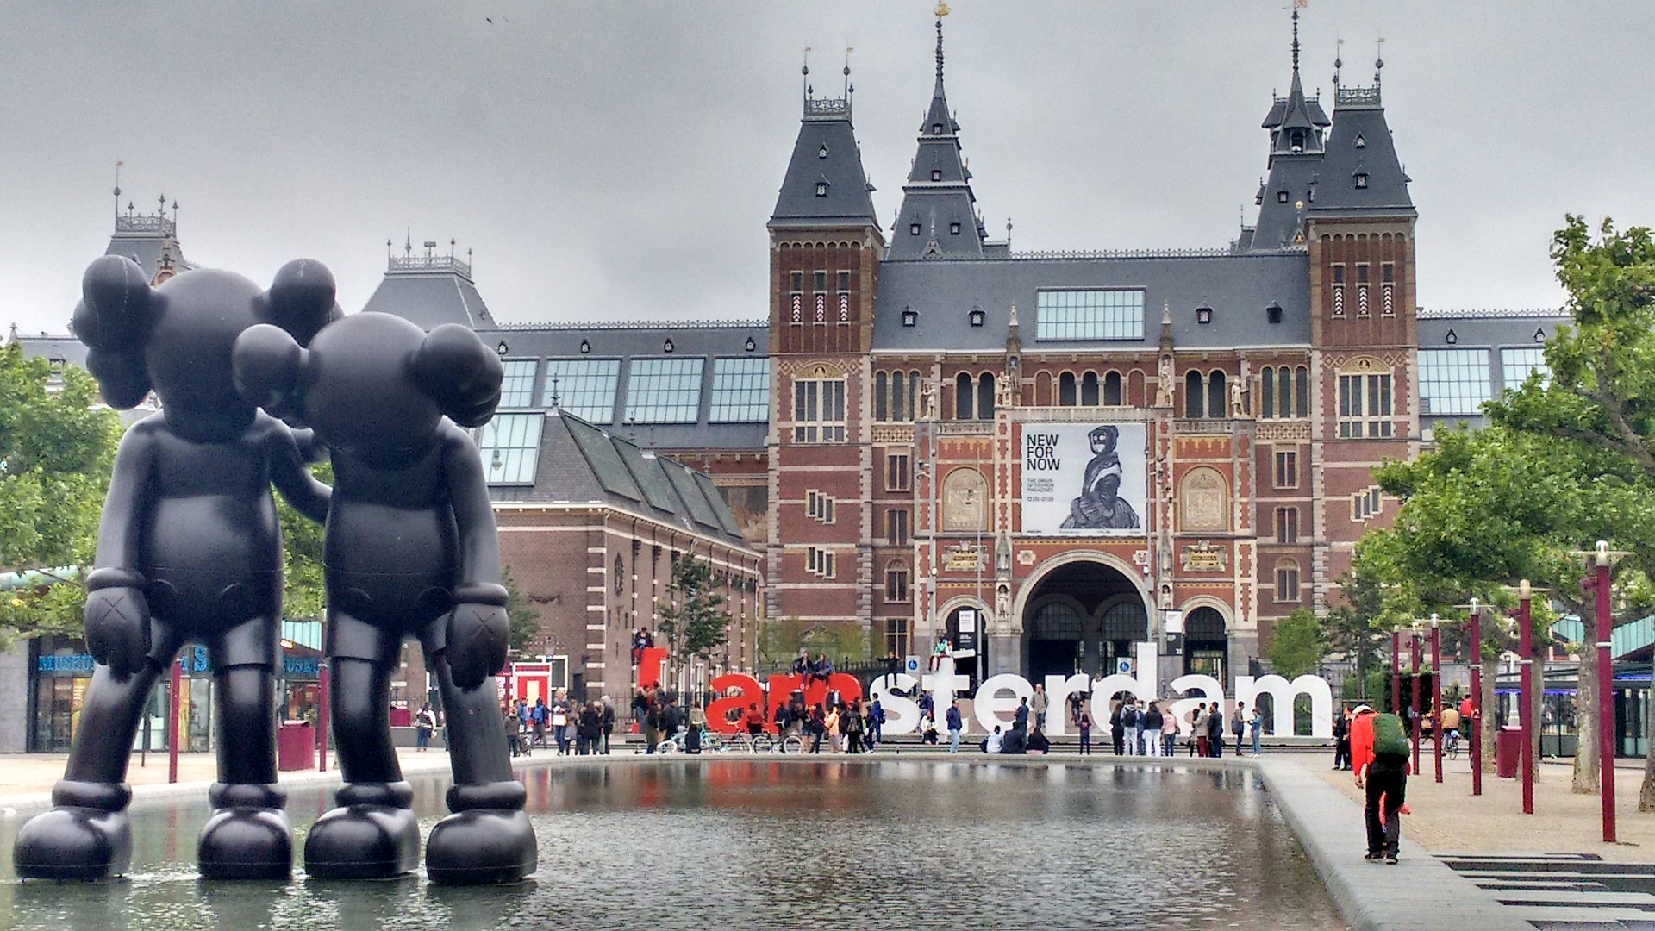

2
Notes:
Amsterdam is the second best place to live sustainably. And
Source: https://www.iamexpat.nl/expat-info/dutch-expat-news/most-sustainable-municipality-netherlands

Slide 9
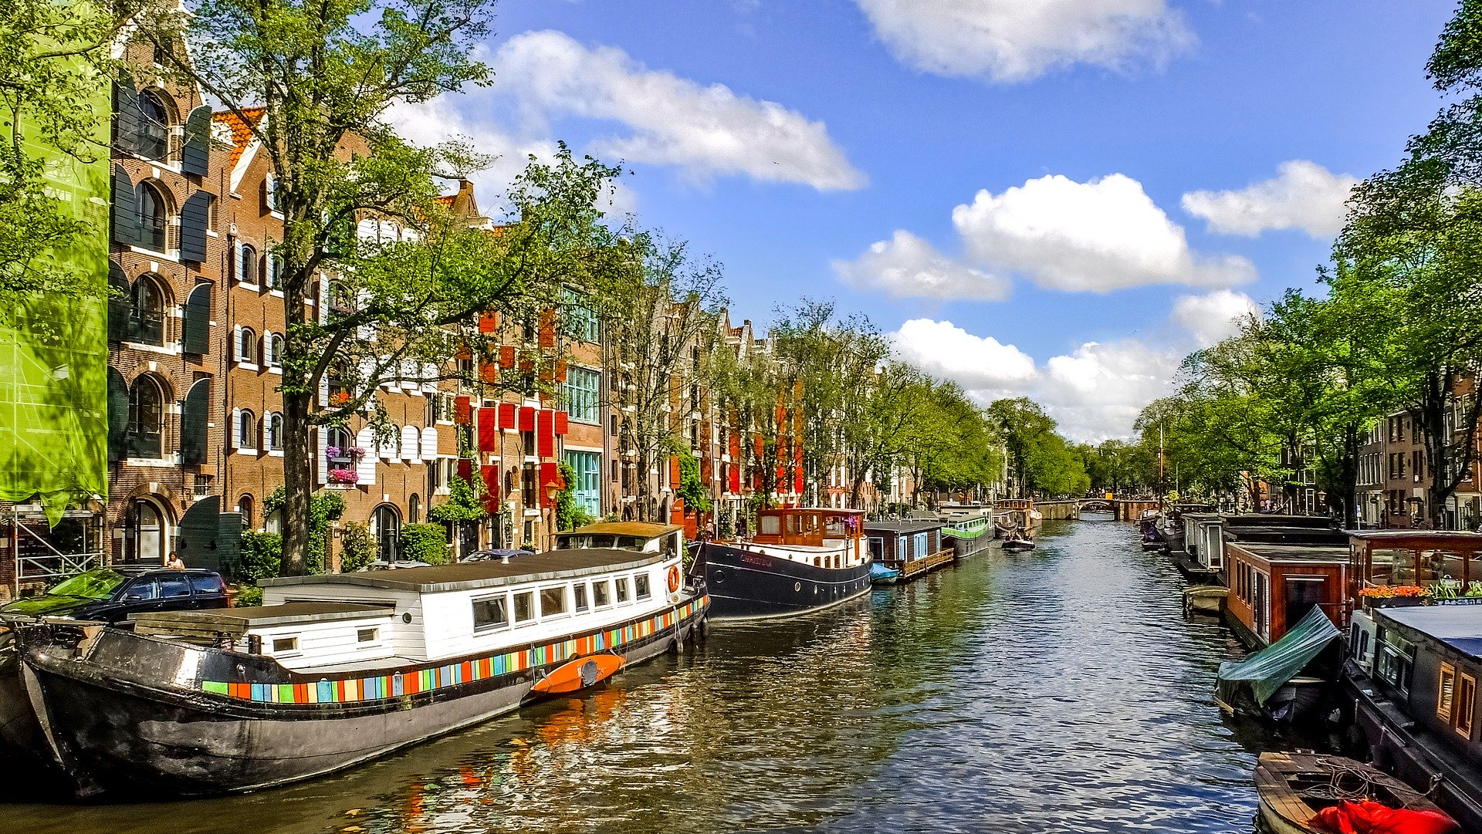
Climate Neutral Amsterdam by 2050
Notes:
Want to be climate Neutral Amsterdam by 2050. And when we are talking about Amsterdam we mean..
Source:http://sustainableamsterdam.com/2020/02/the-road-to-a-climate-neutral-amsterdam-by-2050/

Slide 10
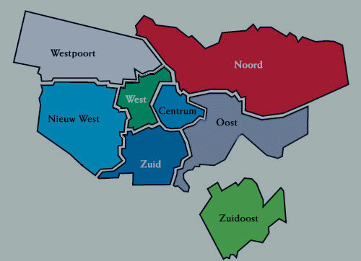
Notes:
Division of neighbourhood explained. With all these division of areas and Amsterdam being a major hub for expats, tourism and many people becoming more and more conscious about sustainability .There came a common question

Slide 11
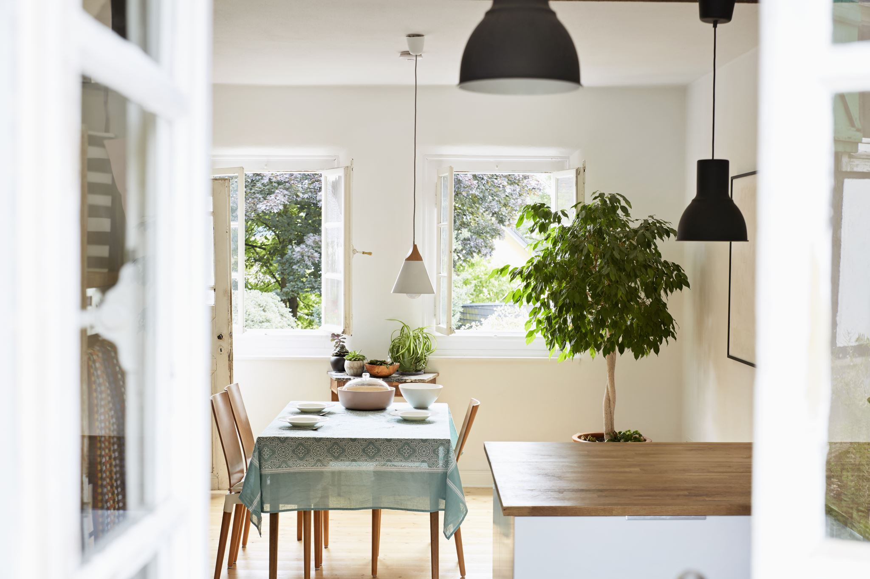

WHICH STADSDELEN IS DOING WELL & WHICH ONE NEED FOCUS

Slide 12





What if….
Accurate Data Analysis
Buildings
Traffic
Electricity
Notes:
What if we tell you that you can get your answer if you can consider the neighbourhood by accurately and carefully analyzing buildings, traffic, ,electricity consumption.But that’s too big a job.Right!!! Do not fear because we bring to you

Slide 13



Slide 14




TEAM
Erin
Building Data Expert
Vincent
Traffic Data Expert
Sudisna
Energy Data Expert

Slide 15






Sustainable is gezellig
Which neighborhood is most sustainable?

Slide 16
Erin
Building Data Expert

Slide 17

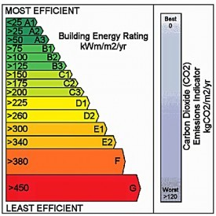

Indicates the energy performance of the building based on the energy use for space and hot water heating, ventilation and lighting for a standard occupancy.

Slide 18
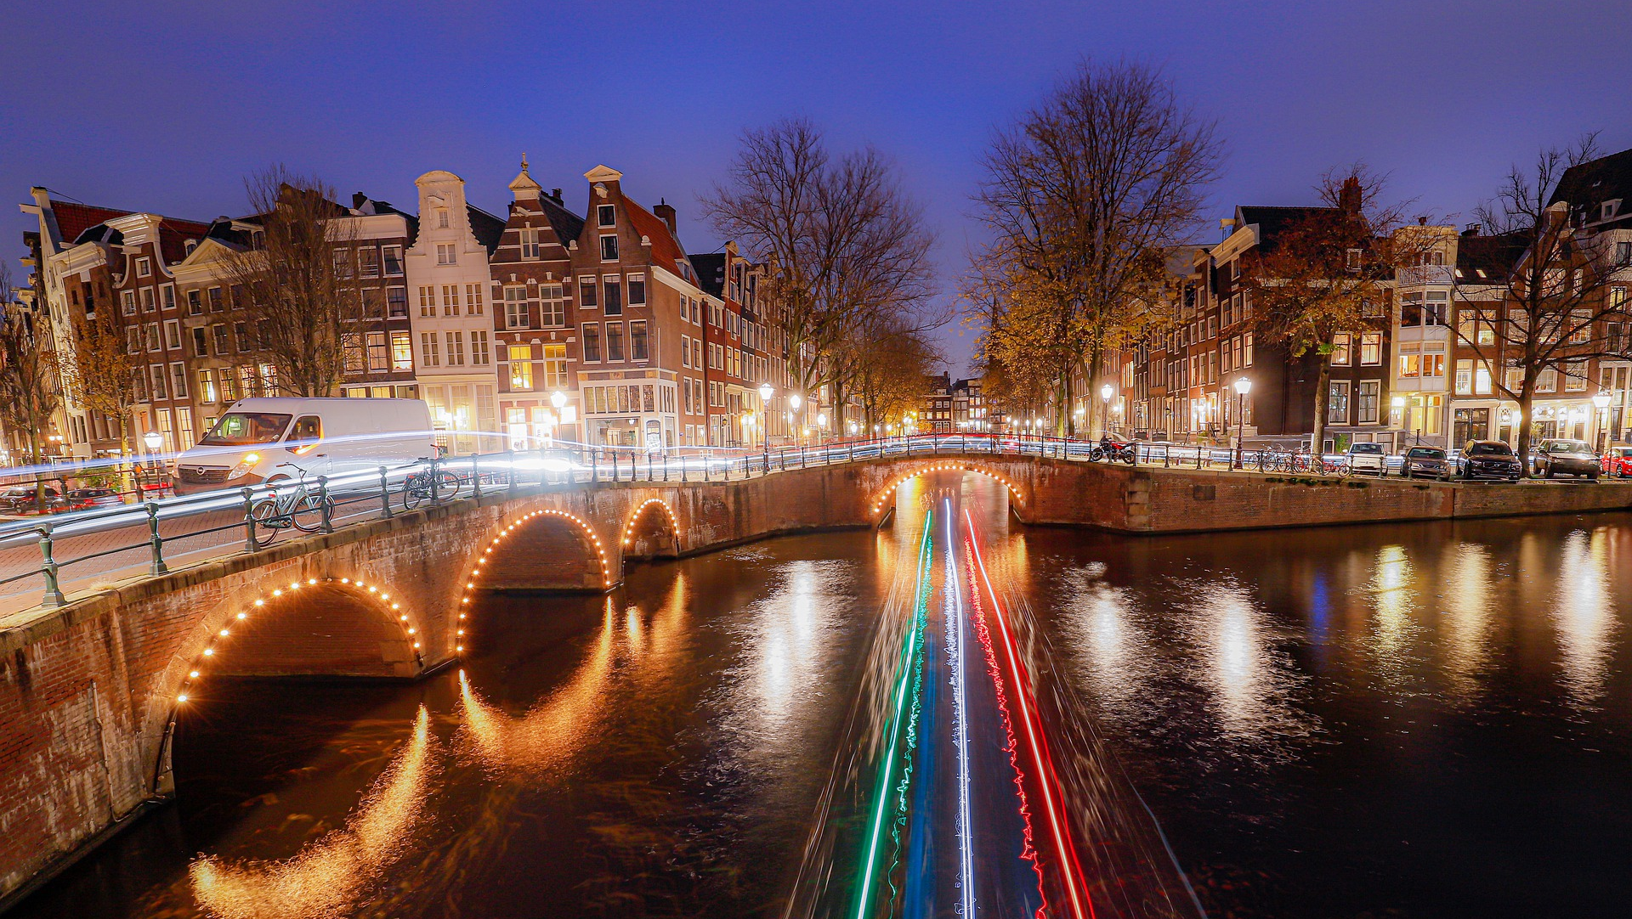
Amsterdam Sustainable Building Goals
CO₂ Neutral
2050
Natural Gas Free
2040
Notes:
Source: https://www.amsterdam.nl/bestuur-organisatie/volg-beleid/ambities/gezonde-duurzame-stad/klimaatneutraal/#h6e48e28e-9b1f-409d-

Slide 19

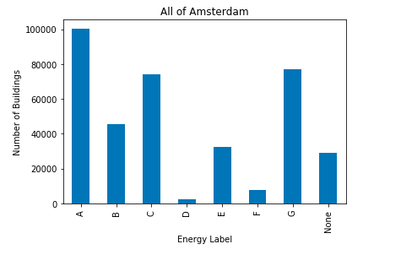

Slide 20
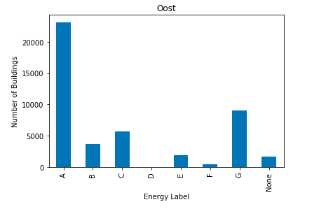
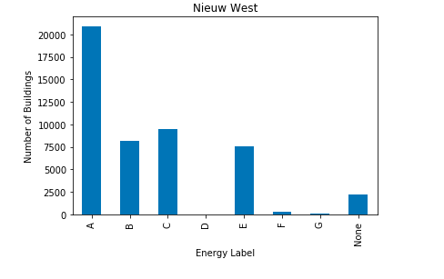
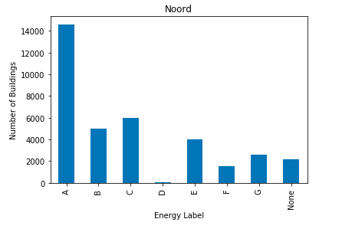
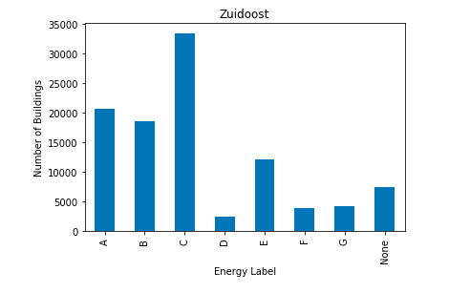

Slide 21
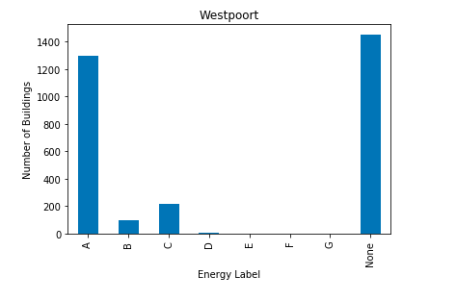
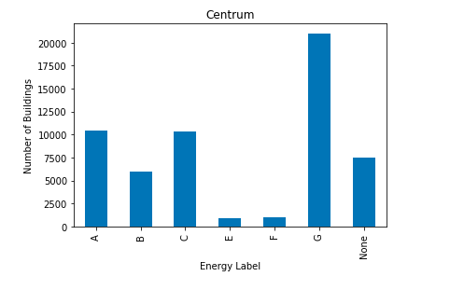
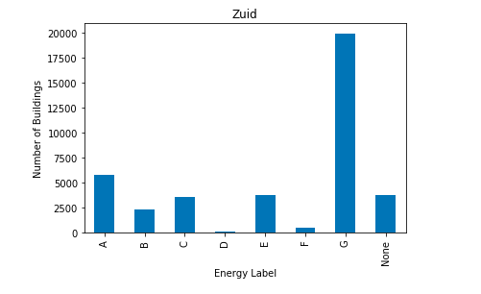
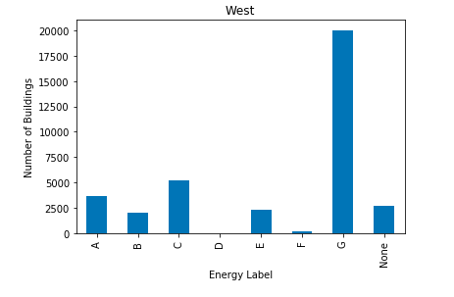

Slide 22
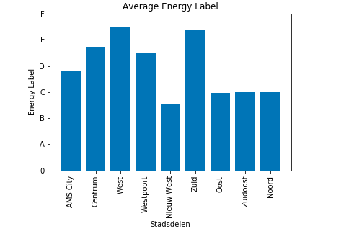

Slide 23
Nieuw
West
Oost
Noord
Top
West
Zuid
Centrum
Focus Areas

Slide 24
VINCENT
Traffic Data Expert

Slide 25
Amsterdam Sustainable Traffic Goals
Emission Free
2030
Notes:
All motorized vehicles will be emission free by 2030
Source: https://www.amsterdam.nl/bestuur-organisatie/volg-beleid/ambities/gezonde-duurzame-stad/klimaatneutraal/#h6e48e28e-9b1f-409d-

Slide 26
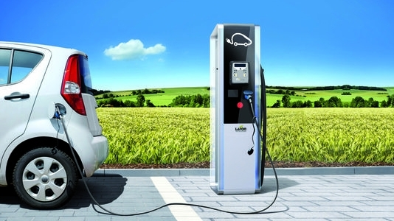
Are charging stations put on the right spot?
1 Looking at current locations of charging stations
This Photo by Unknown Author is licensed under CC BY-SA
Notes:
1 – looking at current locations of charging stations

Slide 27

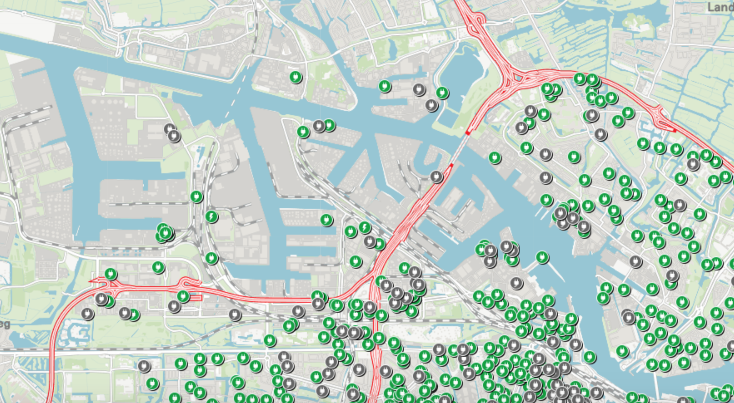
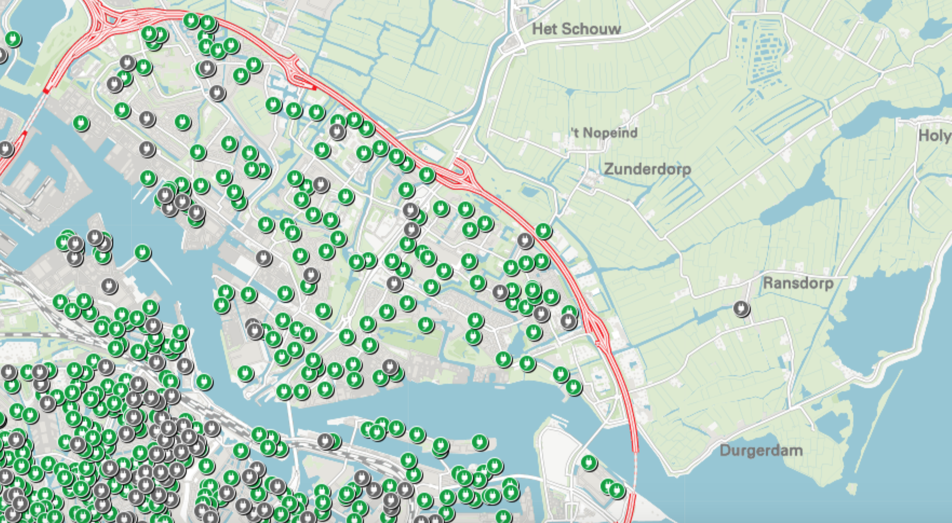
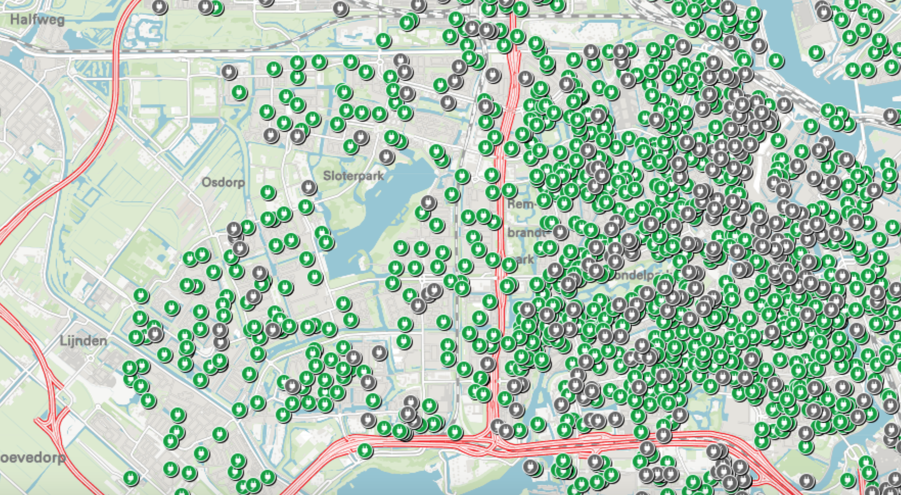
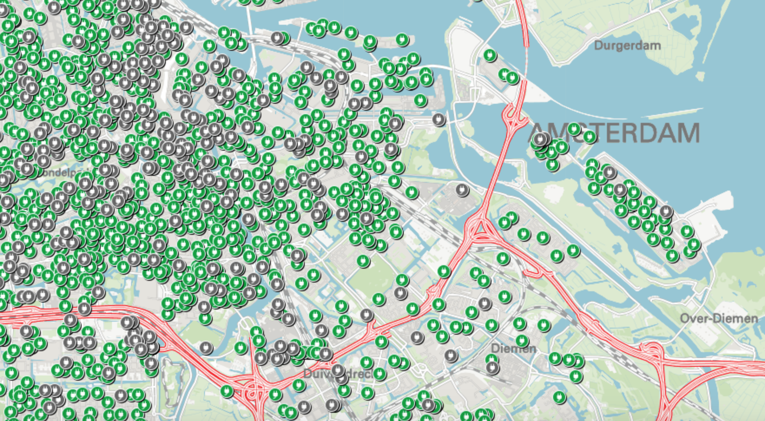
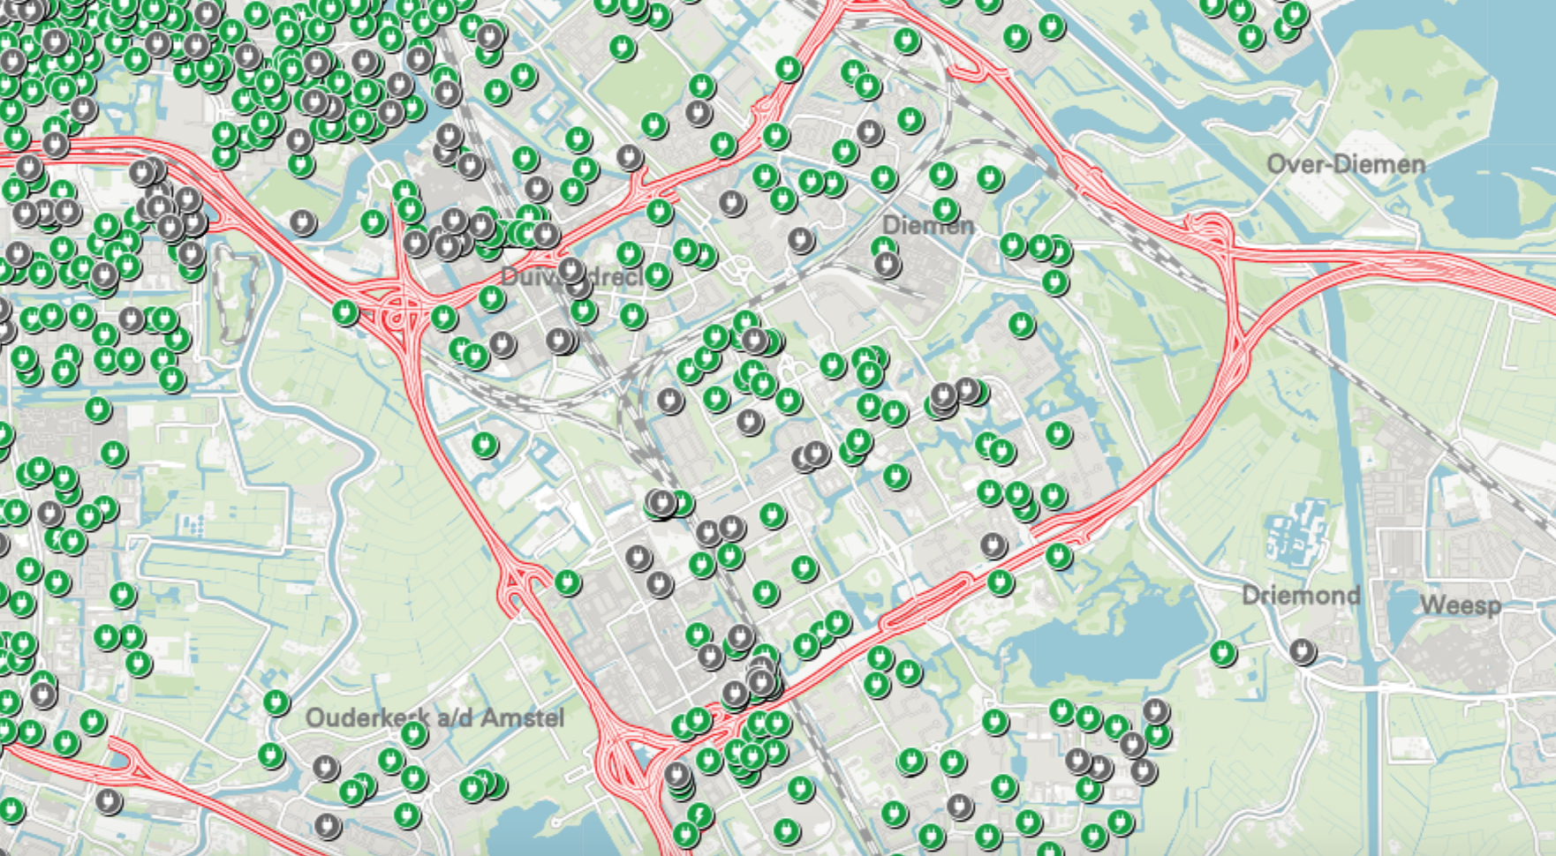
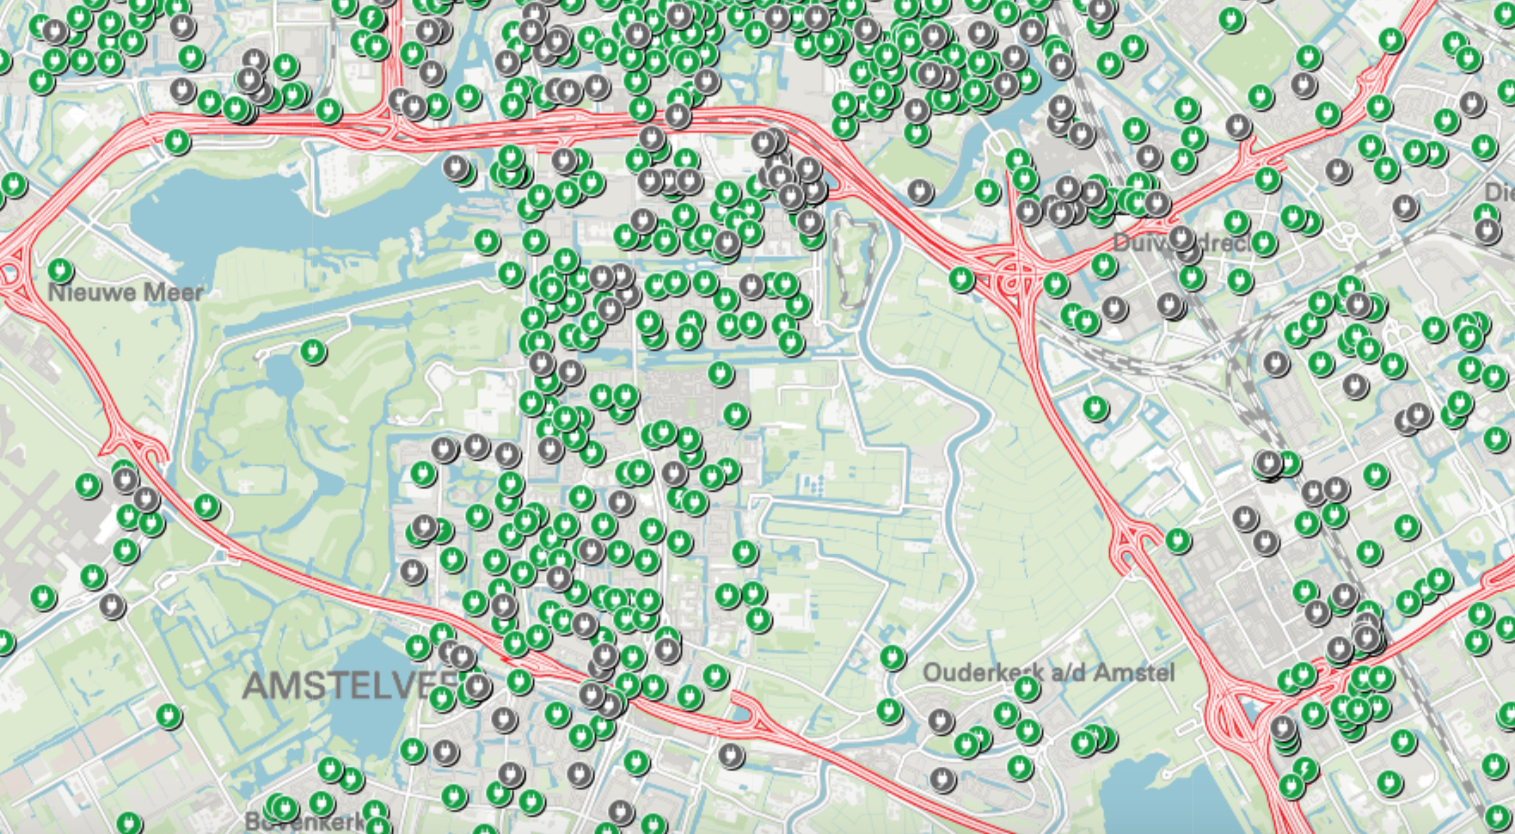
Notes:
Data source: https://data.amsterdam.nl/data/?modus=kaart&lagen=opldp-slpb%3A1%7Copldp-slpnb%3A1%7Copldp-nlpb%3A1%7Copldp-nlpnb%3A1&legenda=true&zoom=8

Slide 28
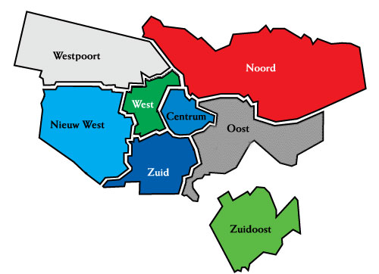
WESTPOORT
NOORD
WEST
CENTRUM
NIEUW WEST
OOST
ZUID
ZUIDOOST

Slide 29


SCALE :
7 most
6 more
5 much
4 average
3 little
2 less
1 least
Stadsdeel | Number of charging stations
Centrum | 6
West | 4
Westpoort | 1
Nieuw west | 3
Zuid | 7
Oost | 4
Zuidoost | 3
Noord | 3

Slide 30
Are charging stations put on the right spot?
1 Looking at current locations of charging stations
2 Looking at relative population growth per stadsdeel
This Photo by Unknown Author is licensed under CC BY-SA
Notes:
1 – looking at current locations of charging stations

Slide 31
Notes:
Data source: https://data.amsterdam.nl/datasets/zoek/?term=bbga

Slide 32
SCALE :
1 highest
2 1,5% - 2%
3 1% - 1,5%
4 0,5% - 1%
5 0% - 0,5%
6 -0,5% - 0%
7 lowest
Stadsdeel | Number of charging stations | Average population growth (2016-2020)
Centrum | 6 | 5 (0,21%)
West | 4 | 4 (0,64%)
Westpoort | 1 | 7 (-10,52%)
Nieuw west | 3 | 2 (1,75%)
Zuid | 7 | 4 (0,68%)
Oost | 4 | 1 (2,00%)
Zuidoost | 3 | 3 (1,22%)
Noord | 3 | 2 (1,68%)

Slide 33
Are charging stations put on the right spot?
1 Looking at current locations of charging stations
2 Looking at relative population growth per stadsdeel
3 Looking at growth in number of companies per 1000 inhabitants per stadsdeel
This Photo by Unknown Author is licensed under CC BY-SA
Notes:
1 – looking at current locations of charging stations

Slide 34
Notes:
Data source: https://data.amsterdam.nl/datasets/zoek/?term=bbga

Slide 35
SCALE (Average growth of companies per 1000 inhabitants: )
1 highest
2 3% - 4%
3 2% - 3%
4 1% - 2%
5 0%- 1%
6 -1% - 0%
7 lowest
Stadsdeel | Number of charging stations | Average population growth (2016-2020) | Average growth in number of companies per 1000 inhabitants (2015-2019)
Centrum | 6 | 5 (0,21%) | 4 (1,54%)
West | 4 | 4 (0,64%) | 5 (0,37%)
Westpoort | 1 | 7 (-10,52%) | 1 (10,90%)
Nieuw west | 3 | 2 (1,75%) | 4 (1,11%)
Zuid | 7 | 4 (0,68%) | 2 (3,20%)
Oost | 4 | 1 (2,00%) | 7 (-0,73%)
Zuidoost | 3 | 3 (1,22%) | 2 (3,16%)
Noord | 3 | 2 (1,68%) | 4 (1,96%)

Slide 36
Are charging stations put on the right spot?
1 Looking at current locations of charging stations
2 Looking at relative population growth per stadsdeel
3 Looking at growth in number of companies per 1000 inhabitants per stadsdeel
This Photo by Unknown Author is licensed under CC BY-SA
Notes:
1 – looking at current locations of charging stations

Slide 37
Stadsdeel | Number of charging stations | Average population growth (2016-2020) | Average growth in number of companies per 1000 inhabitants (2015-2019) | Attention area?
Centrum | 6 | 5 (0,21%) | 4 (1,54%) | No (15)
West | 4 | 4 (0,64%) | 5 (0,37%) | No (13)
Westpoort | 1 | 7 (-10,52%) | 1 (10,90%) | Unclear (9)
Nieuw west | 3 | 2 (1,75%) | 4 (1,11%) | Yes (9)
Zuid | 7 | 4 (0,68%) | 2 (3,20%) | No (13)
Oost | 4 | 1 (2,00%) | 7 (-0,73%) | No (12)
Zuidoost | 3 | 3 (1,22%) | 2 (3,16%) | Yes (8)
Noord | 3 | 2 (1,68%) | 4 (1,96%) | Yes (9)
Notes:
Low in total points means: currently low in charging stations, high population growth and high growth in number of
companies per 1000 inhabitants SO more charging stations needed.

Slide 38
Centrum
West
Zuid
Oost
Top
Noord
Zuidoost
Nieuw West
Focus Areas

Slide 39
SUDISNA
Energy Data Expert

Slide 40

Amsterdam Sustainable Energy Goals
1 Mln Solar Panel
2020
Notes:
Source: https://www.worlddata.info/europe/netherlands/energy-consumption.php
Source: https://citycentreretreat.com/amsterdam-energy-cost.php

Slide 41
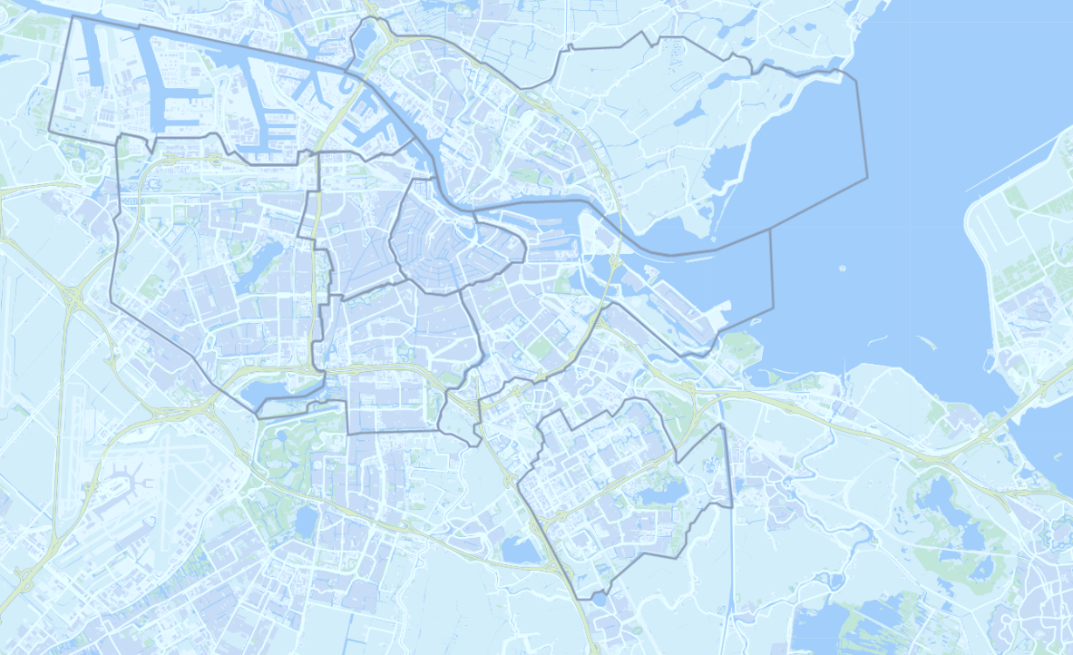
Westpoort
Noord
West
Centrum
Nieuwe West
Oost
Zuid
Zuidoost
Notes:
Source : https://www.worlddata.info/europe/netherlands/energy-consumption.php
Source :https://maps.amsterdam.nl/open_geodata/

Slide 42
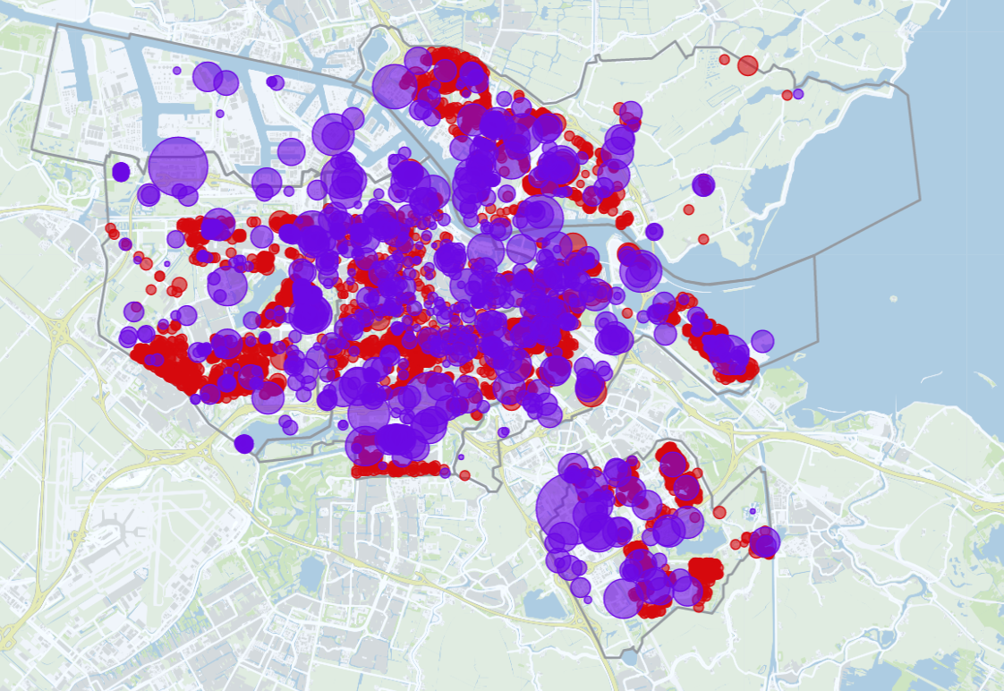
Westpoort
Westpoort
Noord
Noord
West
West
Centrum
Nieuwe West
Centrum
Nieuwe West
Oost
Oost
Zuid
Zuid
Zuidoost
Notes:
Source : https://www.worlddata.info/europe/netherlands/energy-consumption.php

Slide 43

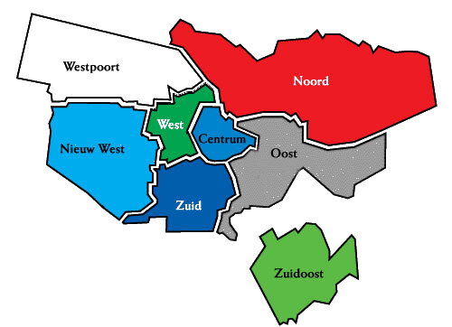

Slide 45
Nieuw
West
Oost
Noord
Top
Westpoort
Zuidoost
Centrum
Focus Areas

Slide 46

Neighbourhood comparison
Buildings
Traffic
Energy
Focus
High
Focus
Centrum
High
Focus
High
Noord
Focus
High
Medium
West
High
Focus
High
Nieuw West

Slide 47
Neighbourhood comparison
Buildings
Traffic
Energy
Medium
Unclear
Focus
Westpoort
Focus
High
Medium
Zuid
High
High
High
Oost
Medium
Focus
Focus
Zuidoost

Slide 48

RECOMMENDATION
Oost
Most Sustainable area to live in
ZuidOost
Area to focus
It is an upcoming city which has just started developing
Centrum
Area to focus
Presence of historical building can be cause of more electric consumption but it can be upped by putting more solar panels

Slide 49



